Slide 1
FILE IO

Slide 2

Motivation

Slide 3
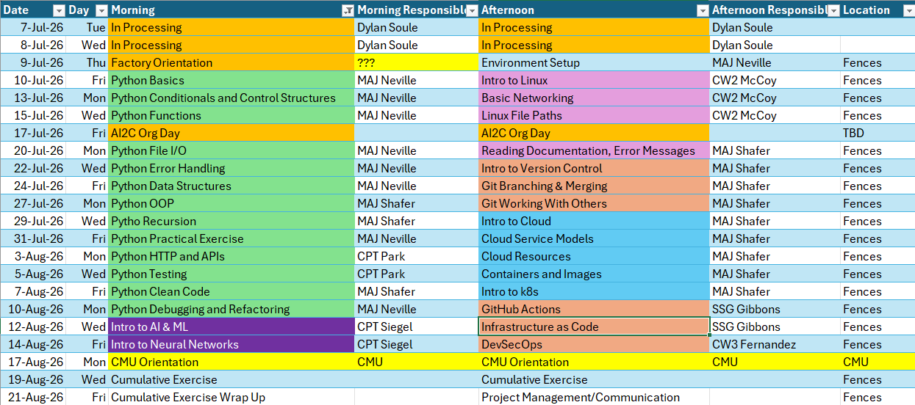
Course Schedule

Slide 4
Review

Slide 5
What is the purpose of user defined functions?

Slide 6
How do you define a function, and how do you use it?

Slide 7
Pre Class Problem 1 - The ULTIMATE RPS Simulation (20 min)
Starting from scratch write a python script that allows you to play rock, paper, scissors against the computer.
However, in this version you will ask the user how many games they want to play to determine the overall winner. The computer has other things to do, so it will only accept playing the best of 1 to 9 games. Example: How many games would you like to play to determine who is the ultimate winner? Implied: User input can only be an odd number from 1 to 9. Continue to ask the user to re-enter how many games they would like to play until the user meets these criteria.
Also implied: If the user wants to play the best of 3 games, and wins the first two, they do not need to play a third game.
Bonus: Incorporate ASCII-ART and delays into your game to add some flare.
DO NOT USE GENERATIVE AI – PUSH YOURSELF TO FIGURE THIS OUT

Slide 8
Problem 1 Assessment
Grade | Criteria
D | You can play one game of RPS against the computer.
C | You can specify the number of games to play, but the computer plays all of the games without determining “best of” the number of games.
B | Input is validated correctly, so only 1, 3, 5, 7, or 9 games can be played.
A | Input is validated correctly, and the game incorporates best-of analysis (i.e. if the user wants to play 3 games and wins the first 2, the third game will not be played.
A+ | Added ASCII Art and delays for style

Slide 9
Pre Class Problem 2 - Pizza Shop Shenanigans (20 min)
Your local pizza shop (“Byte da Pi”) is rolling out so-called ‘deals’ on the regular, but you’ve become suspicious if they are actually deals.
For instance, this week Byte da Pi is offering two small pizzas (10” diameter) for $19.99. However, their regular priced large pizza (16” diameter) is priced $20.99. Are the two small pizzas really a deal at $19.99?
Implied: You need to determine the area of the pizzas.
Solve for this specific deal, and then create two functions to help you solve for any deal.
The first function should determine the price per square inch of pizza. How many parameters will this function have?
The second function should compare deals based on $/in² and quantity of pizzas offered in the deal. This function should have four parameters. What are they?
BONUS: If your program finds it to be a good deal, your python script should open the webpage of a local pizza shop. If your program finds it to be a bad deal, tell the user, and open the webpage of a pizza chain (Dominoes/Papa Johns…). Also add ASCII Art.

Slide 10
Problem 2 Assessment
Grade | Criteria
D | You correctly solve the given deal
C | You write a function to determine price per in squared.
B | You write a function to compare prices and quantity of pizzas.
A | Your python script successfully opens webpages based on the outcome.
A+ | Added ASCII Art

Slide 11
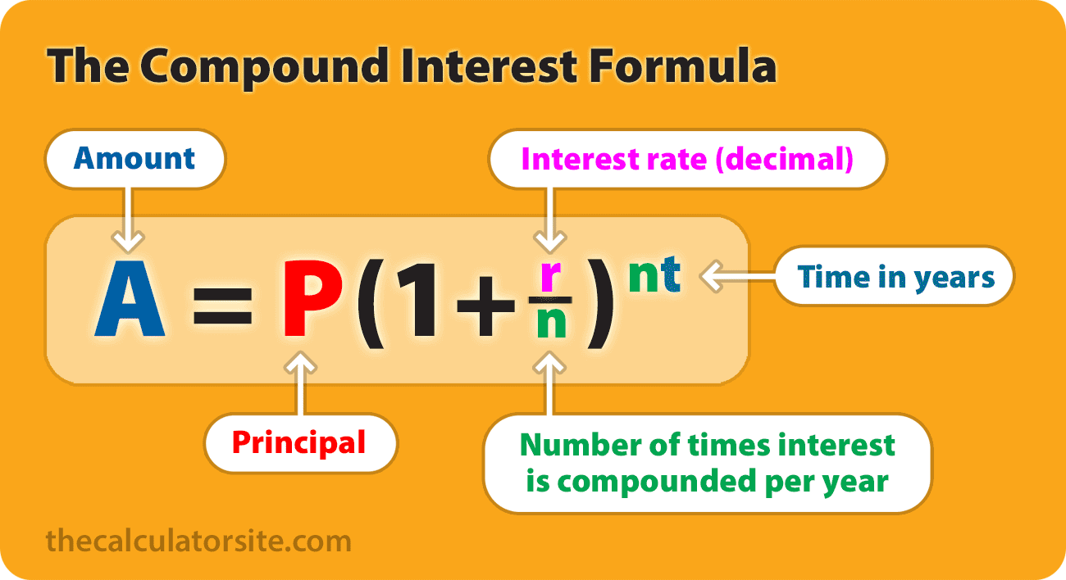
Let’s make this a function:
Pre Class Problem 3 – A simple function (20 min)
Desc. | Principal | Rate | # of times compounded annually | Years | Output
Normal Savings Account | 1000 | 0.0061 | 1 | 10 | $1062.70
Money Market Account (Amex) | 1000 | 0.031 | 1 | 10 | $1357.02
Index Fund | 1000 | 0.07 | 1 | 10 | $1967.15

Slide 12
Today’s Lesson Objectives
Utilize the os and pathlib.Path modules to navigate a filesystem
Utilize standard python functions to manipulate files

Slide 13
OS module
The os module in Python provides a way to interact with the operating system. It offers a portable interface for OS-dependent functionality, meaning your code can work across different platforms (Windows, macOS, Linux) without major changes.

Slide 14
OS module
Core purposes:
1. File & Directory Operations
Create, rename, delete files and directories (os.mkdir(), os.remove(), os.rename())
List directory contents (os.listdir())
Check if paths exist (os.path.exists())
2. Path Manipulation (via os.path)
Join paths portably: os.path.join("folder", "file.txt")
Split paths, get extensions, get filenames
Get absolute paths: os.path.abspath()
3. Environment Variables
Read and set environment variables: os.environ.get("HOME")
Useful for configuration and secrets management

Slide 15
OS module
3. Environment Variables
Read and set environment variables: os.environ.get("HOME")
Useful for configuration and secrets management
4. Process Management
Get the current process ID: os.getpid()
Run shell commands: os.system("ls")
Terminate the process: os.exit()
5. System Information
Get the current working directory: os.getcwd()
Change the working directory: os.chdir()
Detect the OS name: os.name (returns 'nt' for Windows, 'posix' for Unix-like)

Slide 16
OS module EXAMPLE
Example:
import os
# Get current directory
print(os.getcwd())
# Build a cross-platform path
path = os.path.join("data", "reports", "summary.csv")
# Check if it exists
if os.path.exists(path):
print("File found!")
# Read an environment variable
api_key = os.environ.get("API_KEY", "default_value")

Slide 17
OS module CHEATSHEET
Python Function | Description
os.getcwd() | Returns the current working directory.
os.chdir(path) | Changes the current working directory.
os.listdir(path='.') | Lists files and directories in the given path.
os.mkdir(path) | Creates a single directory.
os.makedirs(path) | Creates nested directories recursively.
os.remove(path) | Deletes a file.
os.rmdir(path) | Removes a directory (must be empty).
os.rename(src, dst) | Renames or moves a file or directory.
os.stat(path) | Returns info about a file (like size, modified time).

Slide 18
Look familiar?
Python Function | Description | Linux Command Equivalent
os.getcwd() | Get current working directory | pwd
os.chdir(path) | Change current directory | cd path
os.listdir(path='.') | List files and directories | ls
os.mkdir(path) | Create a directory | mkdir path
os.makedirs(path) | Create nested directories | mkdir -p path
os.remove(path) | Delete a file | rm path
os.rmdir(path) | Remove empty directory | rmdir path
os.rename(src, dst) | Rename or move file/directory | mv src dst
os.stat(path) | Get file/directory status | stat path

Slide 19
Pathlib MODULE
An object-oriented* focused path library
The pathlib module (introduced in Python 3.4) provides an object-oriented approach to filesystem paths, treating paths as objects rather than plain strings. It's the modern alternative to os.path.
Core purposes:
1. Path Creation & Representation
Paths are objects, not strings: p = Path("/home/user/file.txt")
Automatically handles / vs \ across platforms
Use / operator to join paths intuitively: Path("folder") / "sub" / "file.txt“
2. File & Directory Operations
Create directories: p.mkdir(parents=True, exist_ok=True)
Delete files/dirs: p.unlink(), p.rmdir()
Rename/move: p.rename("new_name.txt")
Check existence: p.exists(), p.is_file(), p.is_dir()
3. Reading & Writing Files
Built-in read/write without needing open():

Slide 20
Pathlib MODULE CHEATSHEET
An object-oriented* focused path library
from pathlib import Path
Operation | Example Code
Create / Join Path | Path('folder') / 'file.txt'
Check Existence | p.exists(), p.is_file(), p.is_dir()
Read / Write File | p.read_text(), p.write_text('Hello')
Create Directory | p.mkdir(exist_ok=True)
List Contents | for f in Path('.').iterdir(): print(f)
Search Files | Path('logs').glob('*.txt')
Remove File | p.unlink()
Get File Info | p.stat().st_size, p.stat().st_mtime

Slide 21
Hands-On #1
Navigating file structures with python

Slide 22
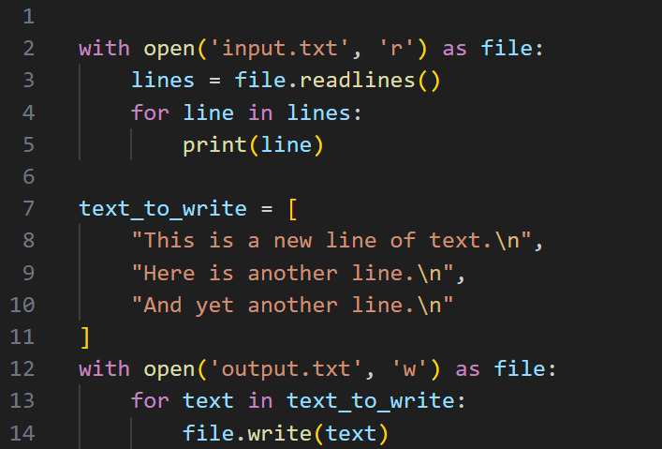
Manipulating files

Slide 23
Common Actions
Operation | Description
with open('file.txt', 'r') as f: pass | Prepare a file for reading
f.read() | Read entire file as a string
f.readlines() | Read file line by line into a list
for line in f: pass | Loop through file line by line
with open('file.txt', 'w') as f: f.write() | Overwrite with new content
with open('file.txt', 'a') as f: pass | Add content to end without erasing existing
f.writelines(lines) | Write a list of strings

Slide 24
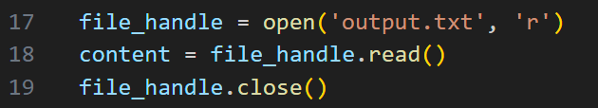
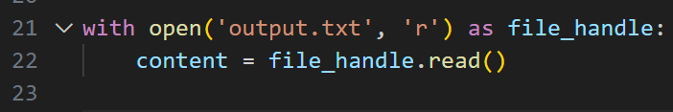
A word about context managers

Slide 25
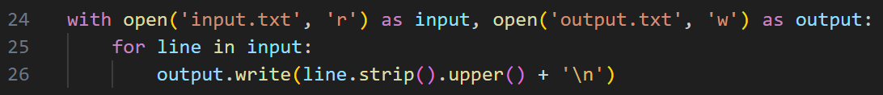
Another word…

Slide 26
Hands-On #2
Manipulate files in python

Slide 27
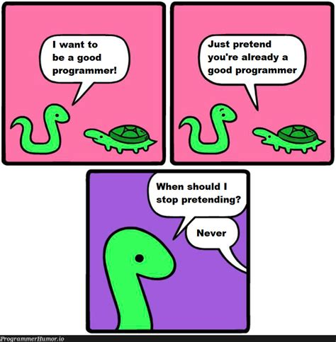
Questions?

